Slide 1

Exploratory Data Analysis For Breast Cancer data

Slide 2
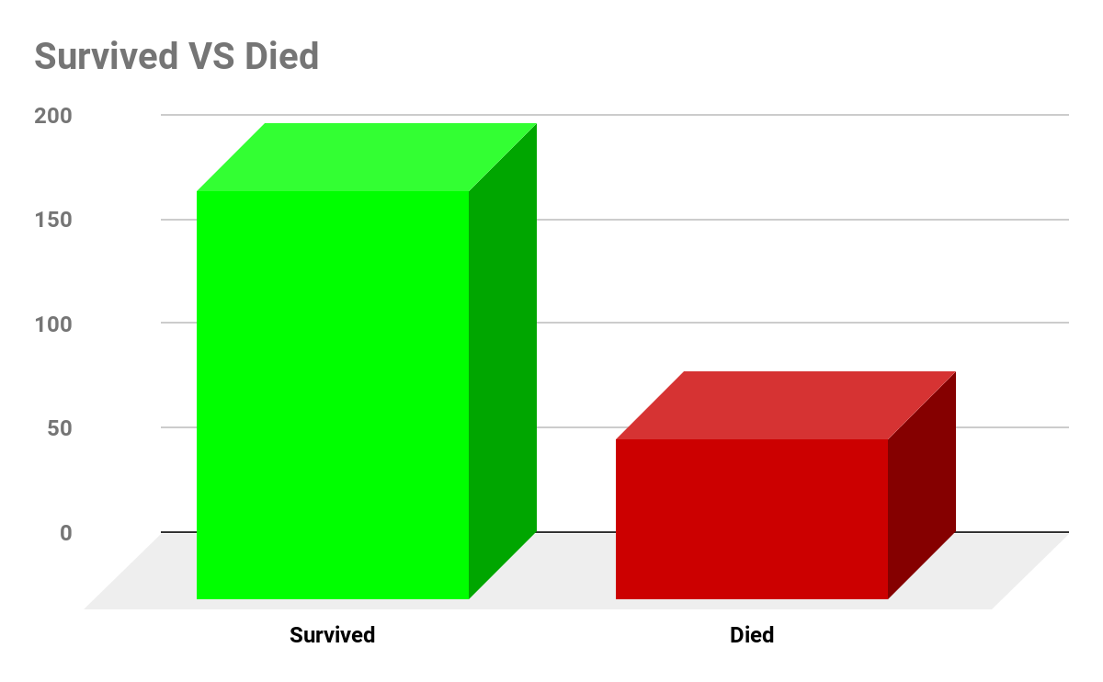
What is The Count Of people With Respect to Status??
Survived had a count of 196 and Died had count of 77

Slide 3
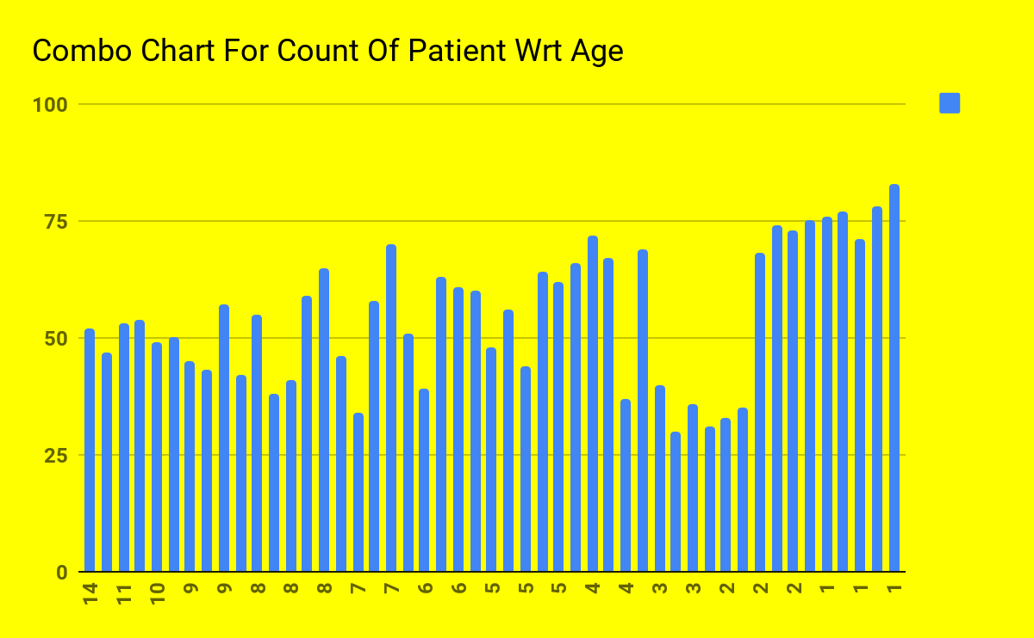
Bar Chart Of Ages Wrt to their Count
Patient with Age 52 Were the Most TO be Operated With a max Count OF 14

Slide 4
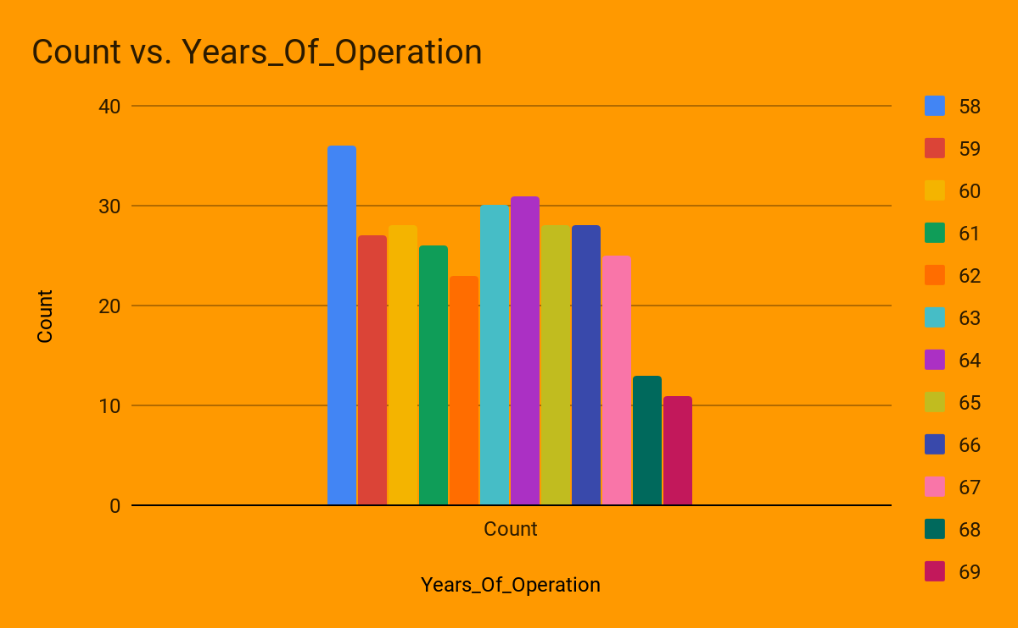
What was The Count of The Patient operated For Each year?
Year 58 had More Number Of Operations And the year 69 had the Least Number Of Operations

Slide 5
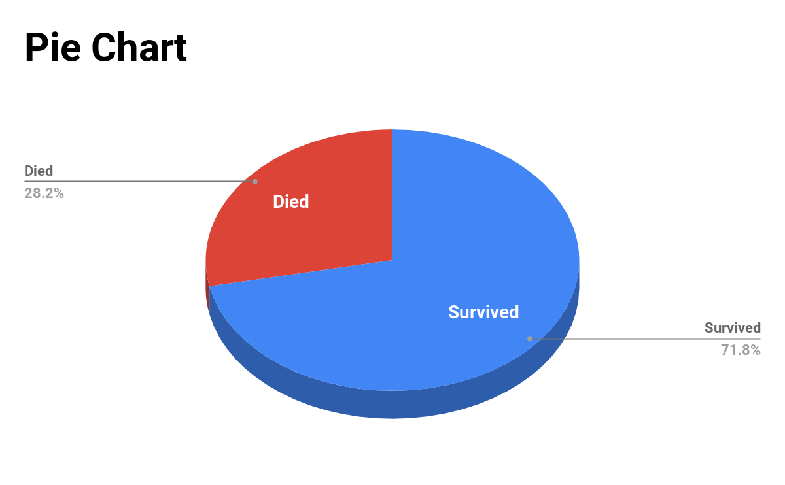
How Many People Survived and How Many People Died in term Of Percrntage?
Survived = 71.79%
Died = 28.20%
Percentage Of the People Survived Was More than The percentage Of the People Died

Slide 6
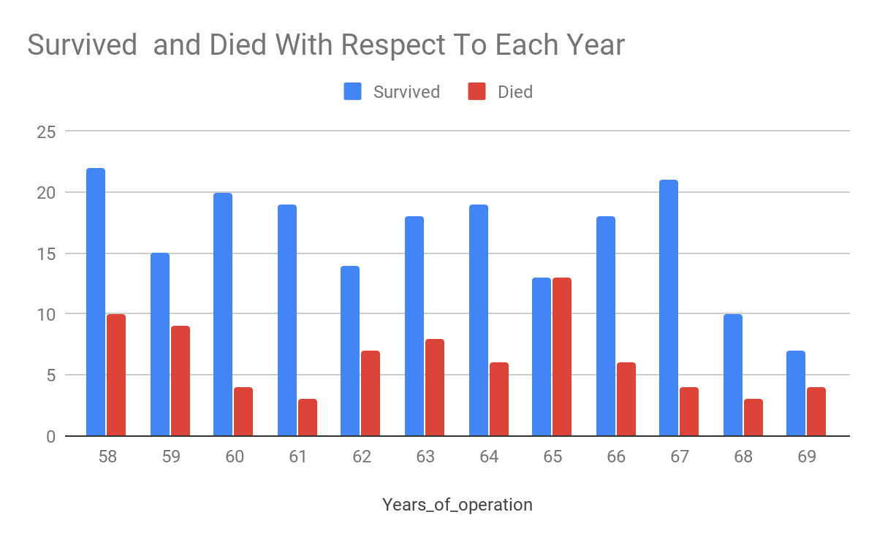
People Operated in Each Year wrt to their Survival Status
Year 61 Had the Max Number Of Survival And The Year 65 Had the Max Number Of deaths

Slide 7
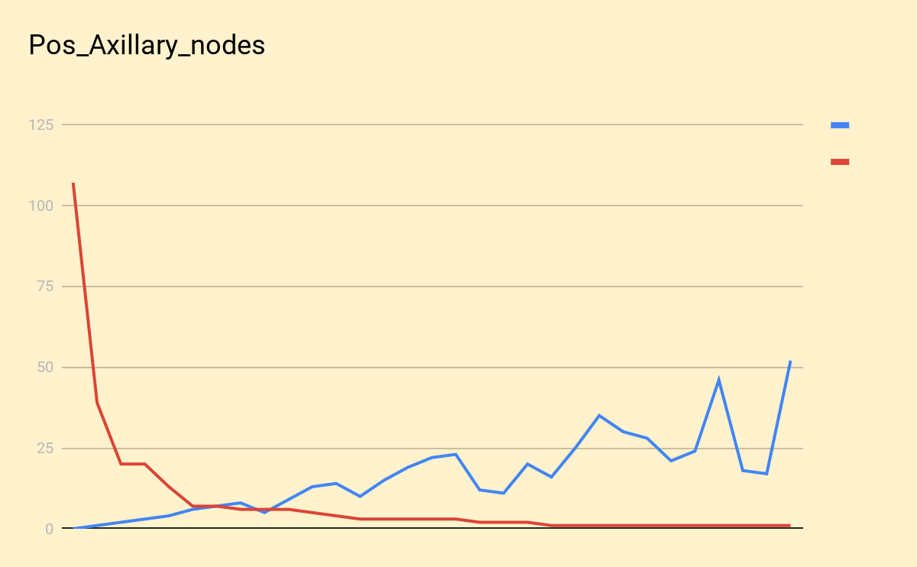
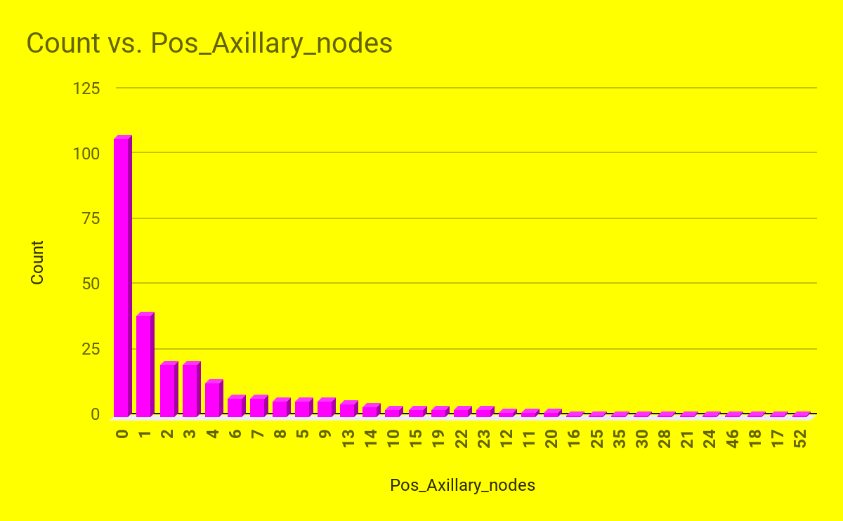
Line Chart and Bar Chart Showing The Count Of Pos_axillary Nodes
We Can See That the People With Pos_Axillary_nodes 0 Were Higest In Number with a count of 107

Slide 8
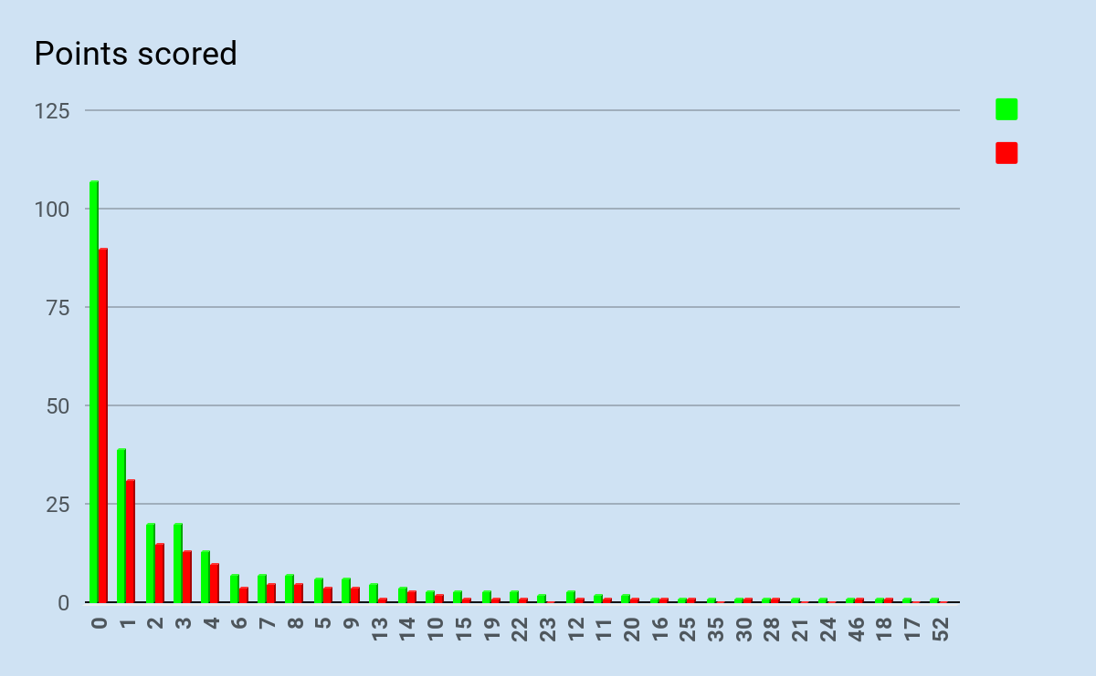
Count Of Pos_axillary_nodes Wrt To The Status
Patients Who had a Pos_axillary_nodes 0 Had Survived The Most Compared To other Patients

Slide 9
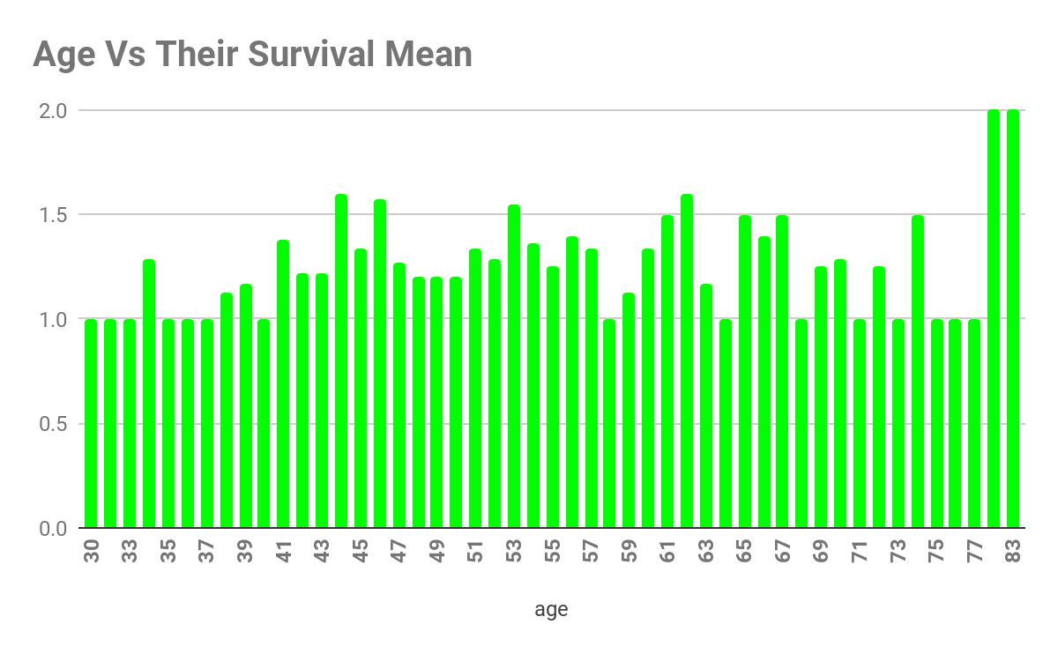
Bar Plot Showing Of ages The Mean values wrt to Status
Its Shows the Mean Distribution Of the Age With Respecct To thier Status

Slide 10
What Could Be Done to increase the survival Status Of the Patients ??
- Arrange for Educational Seminars about the Symptons of Breast Cancer .
- In order to increase the chances of Survival Patients, need to be get operated at earlier Stages of Cancer
- The Frequent Check Ups Will Help in Early detection of Pos_Axillary_nodes and Treatment of Breast Cancer
- More Updated Equipment must be Used By the Organisation which can help in getting accurate results.

